Slide 1
Lab 7
IF, DO and WHILE

Slide 2
IF Condition Statement

Slide 3
Requirement:
Click on Login Button only if it is enabled

Slide 4
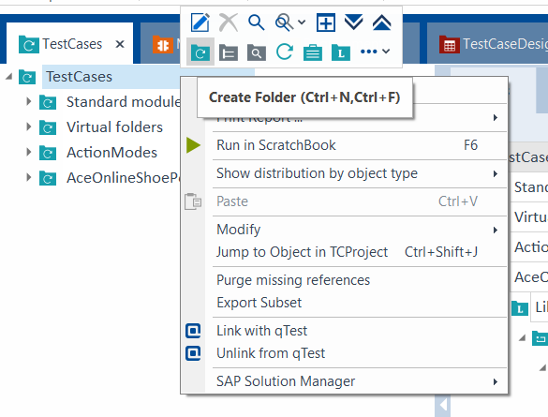
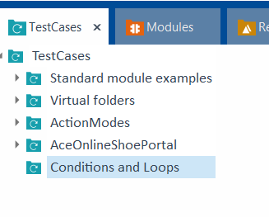
Create a Folder in TestCases for the lab
Rename it

Slide 5
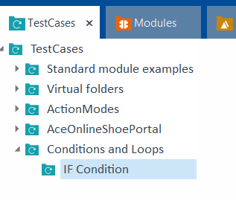
Create a Folder in Conditions and Loops
Rename it

Slide 6
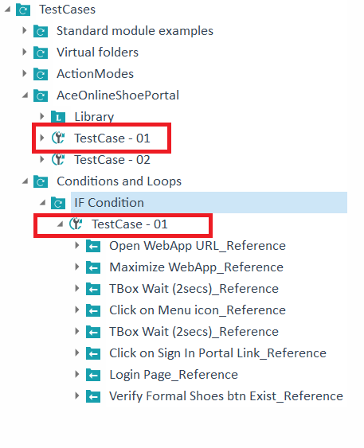
Copy and Paste TestCase-01

Slide 7
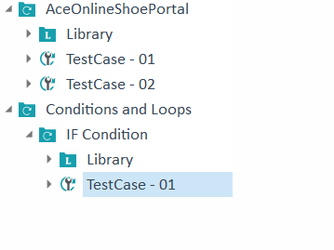
Copy and Paste Library and rearrange

Slide 8
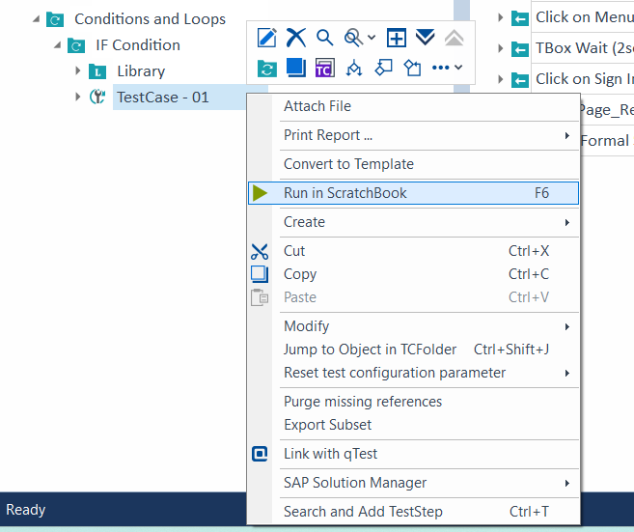
Run TestCase -01

Slide 9
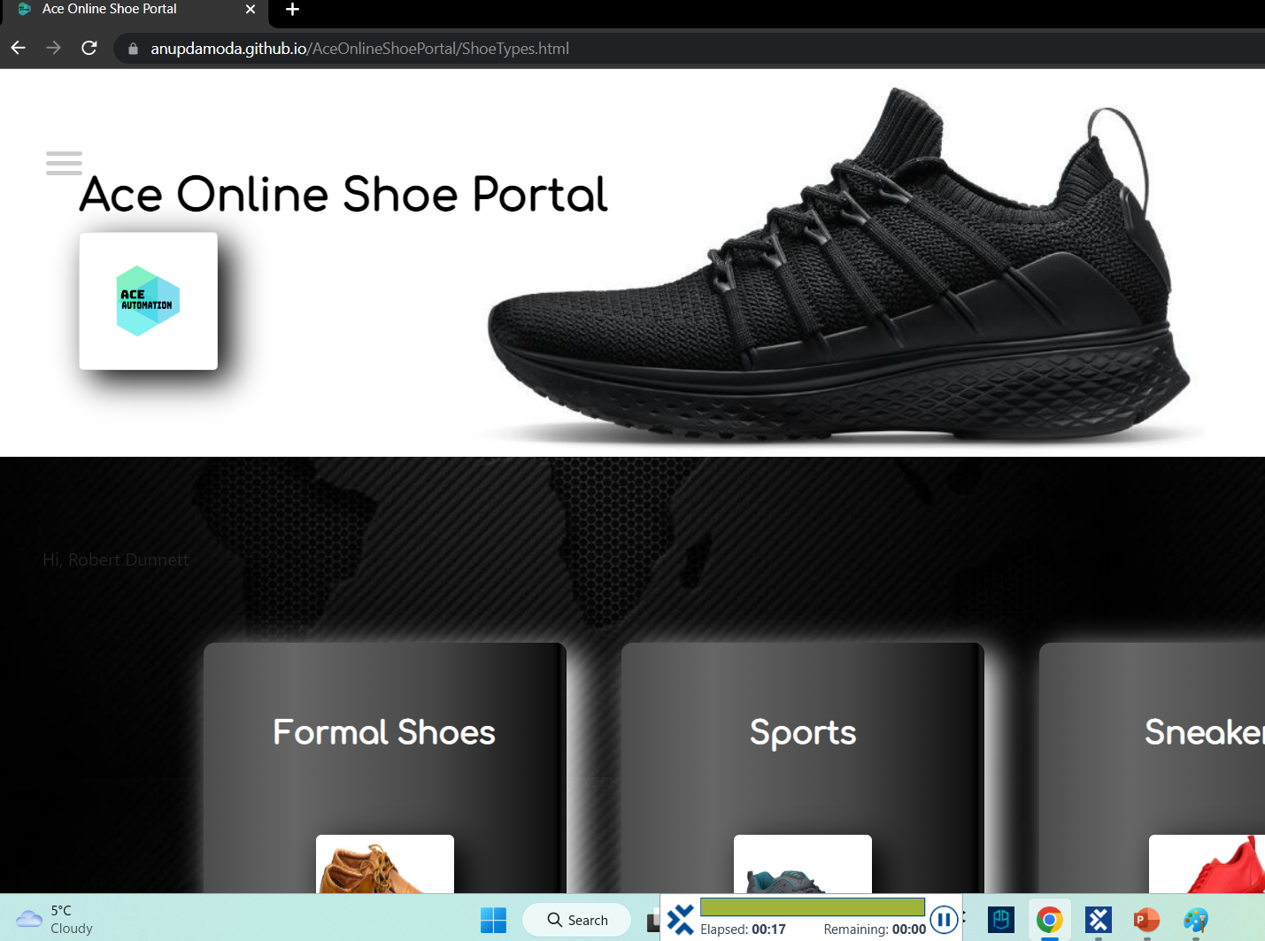
View TestCase -01

Slide 10
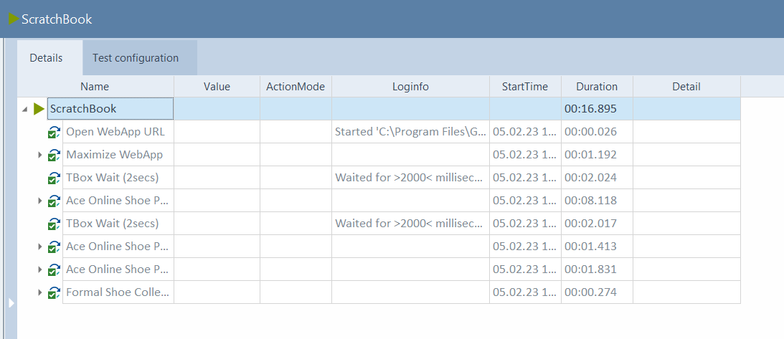
Log of TestCase -01

Slide 11
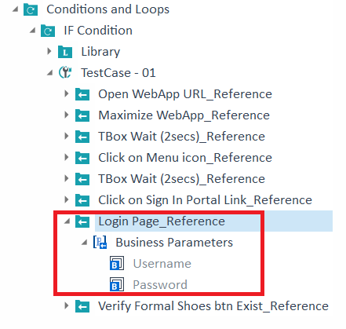
If – Verify if the Login button is enabled before clicking it- on Login Page.

Slide 12
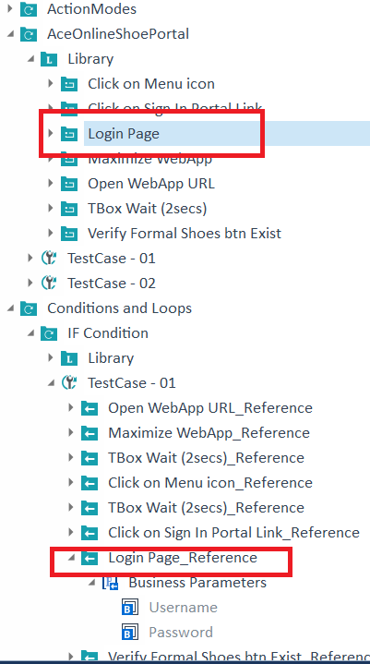
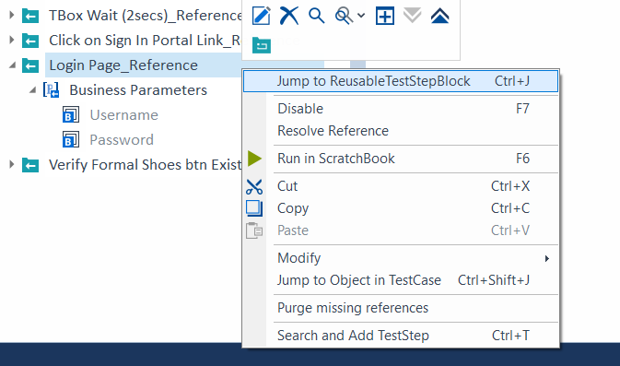
Jump to RTB for the TestCase
Right click and select.

Slide 13
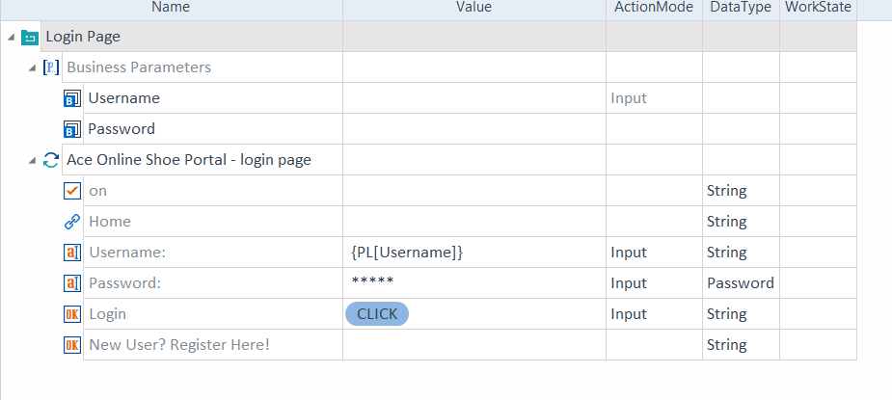
Jump to RTB for the TestCase
Observe that Login is enabled with Click operation.

Slide 14
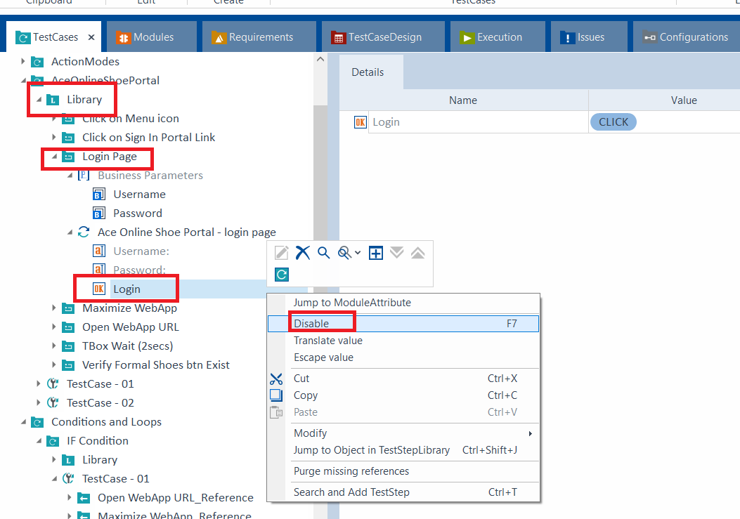
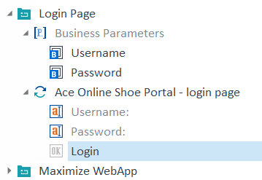
Disable Login button
Diasble Login button in RTB for the TestCase

Slide 15
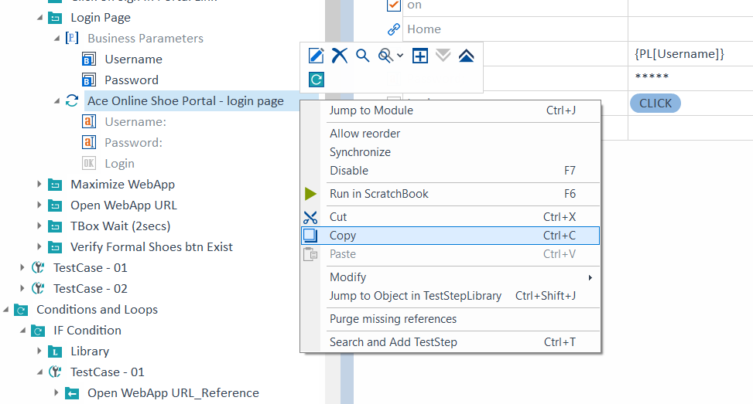
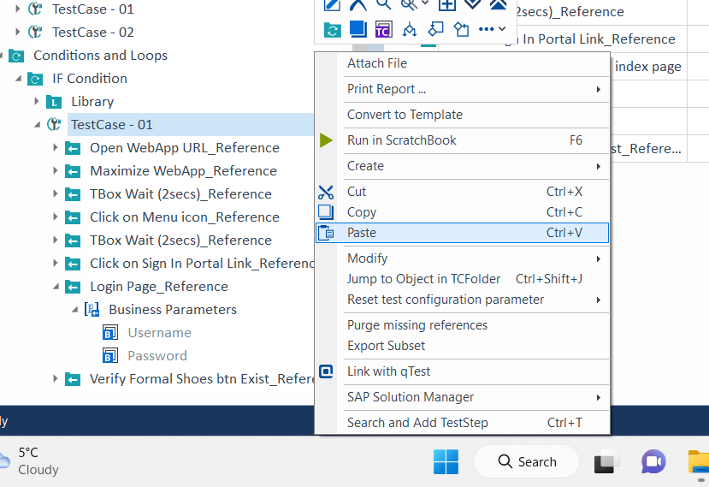
Verify if this button is disabled
Copy the above TestStep and drop it in the Testcase -01 of IF Condition Folder

Slide 16
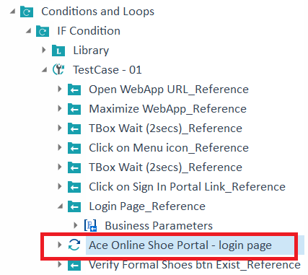
Moved the TestStep to TestCase - 01
Rearrange the TestStep after Login Page TestStep

Slide 17
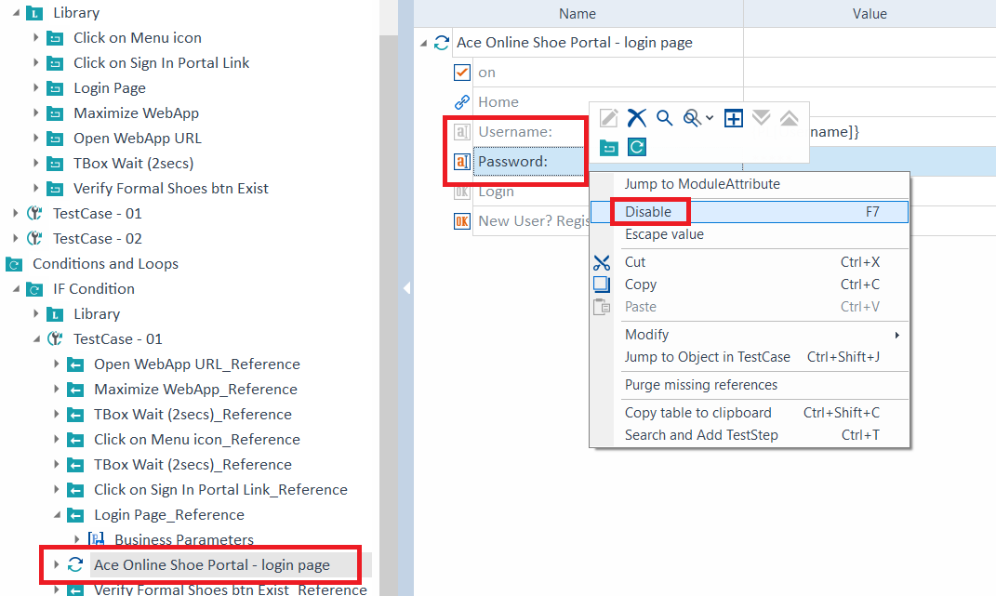
Modify this TestStep -Disable
Disable the username and password as we need only Login button

Slide 18
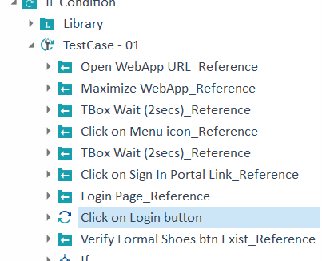
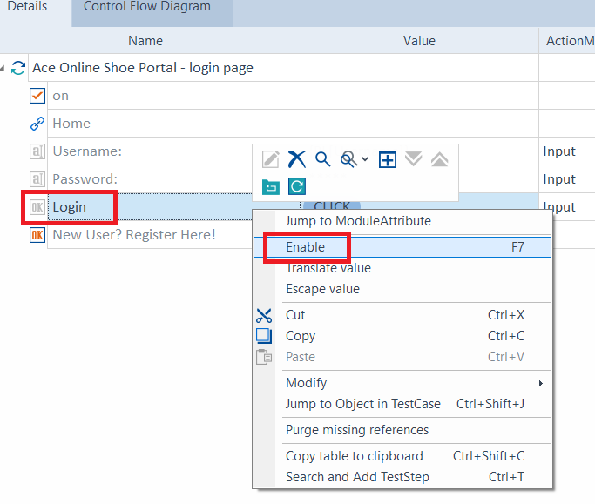
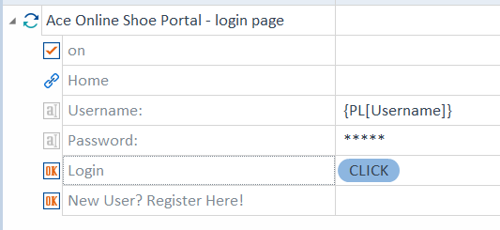
Modify this TestStep - Enable
Enable Login button

Slide 19
Rename this TestStep

Slide 20
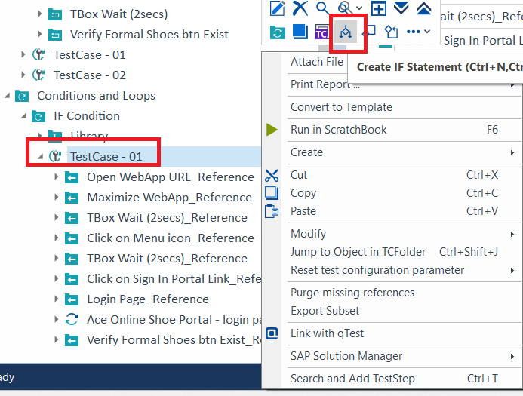
Create a Conditional Loop on TestCase
Enable Login button

Slide 21
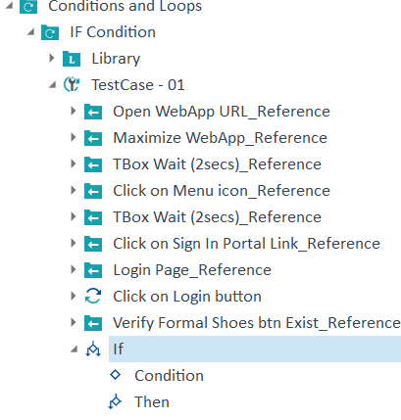
IF Conditional Loop on TestCase
IF Loop is created

Slide 22
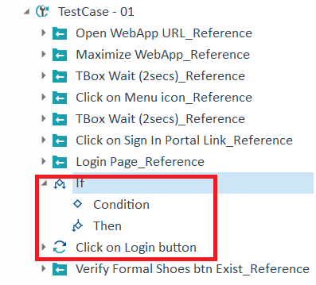
Move the IF Conditional Loop
IF Loop is moved before Click on the Login button

Slide 23
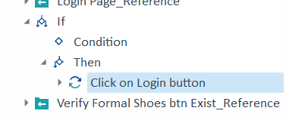
Move the Click on Login Button to THEN
Move TestStep Click on the Login button to THEN of condition

Slide 24
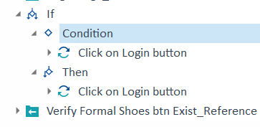
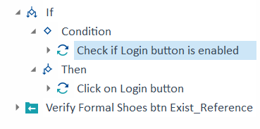
Copy and Paste Click on Login Button to Condition
Rename it

Slide 25
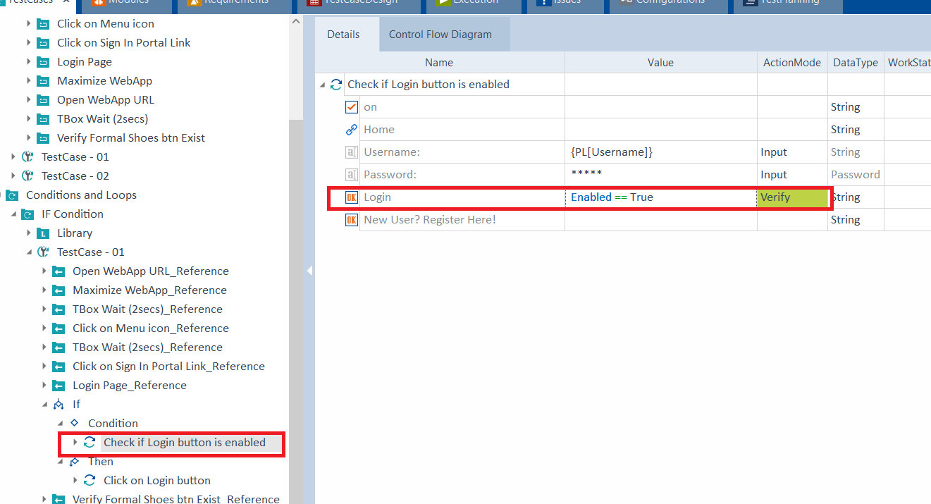
Modify Action Mode for Condition
Verify

Slide 26
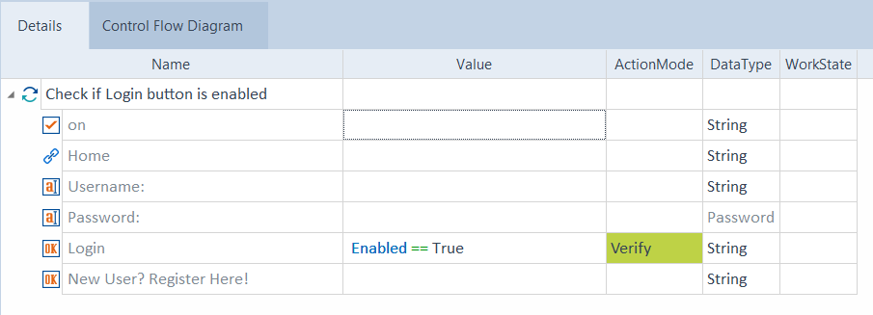
Remove all disabled elements from Condition
Elements will be present but not their values

Slide 27
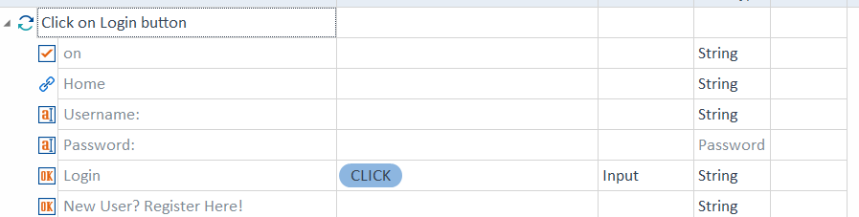
Remove all disabled elements from THEN
Elements will be present but not their values

Slide 28
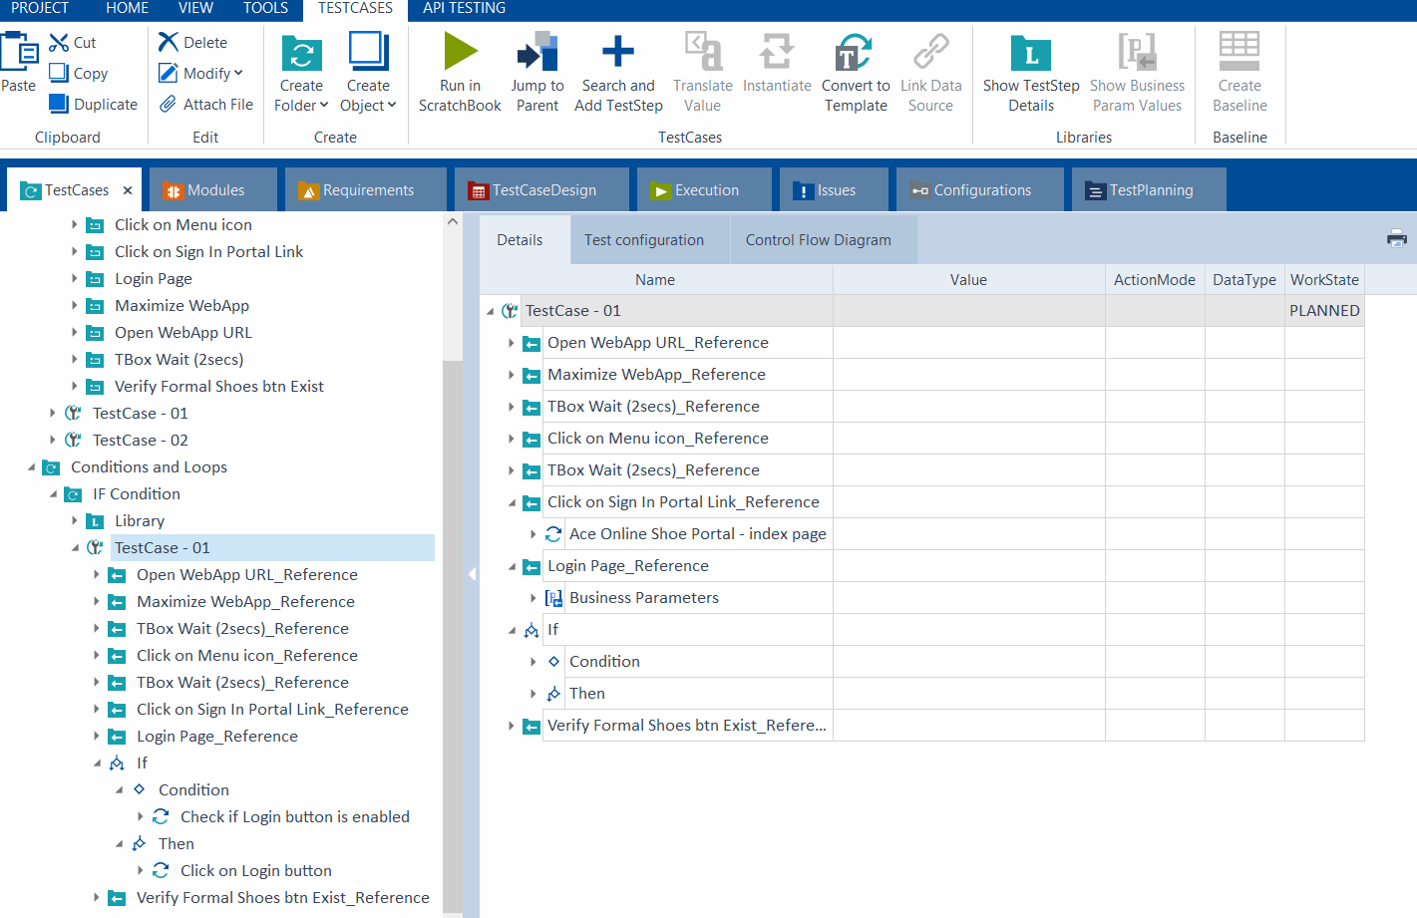
View the TestCase - 01
All TestSteps

Slide 29
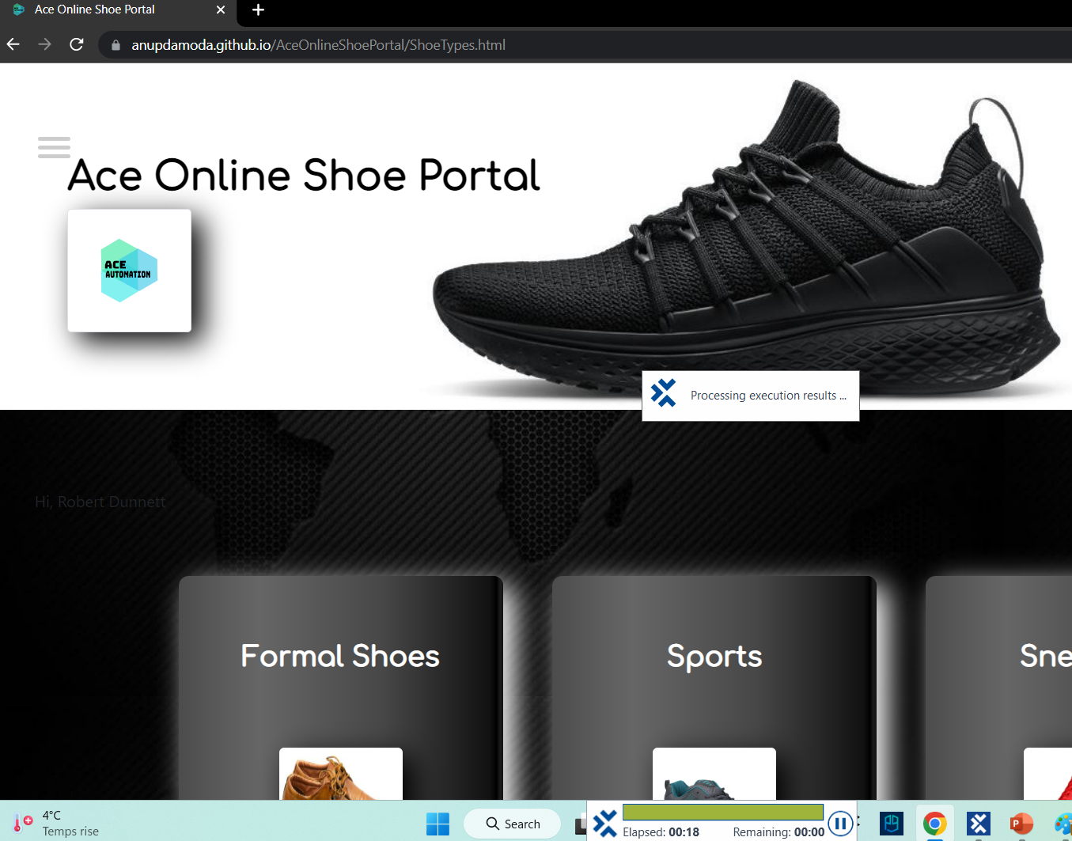
Run the TestCase - 01
Verify it passed

Slide 30
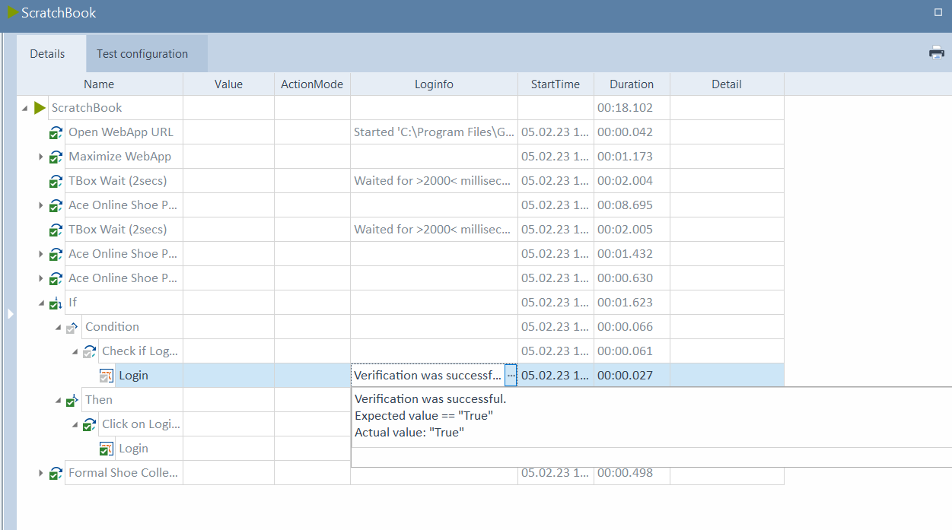
Log of the TestCase - 01
View the log

Slide 31
WHILE LOOP

Slide 32
Requirement:
The user should click only 4 times to view the error message: you clicked more than 3 times.

Slide 33
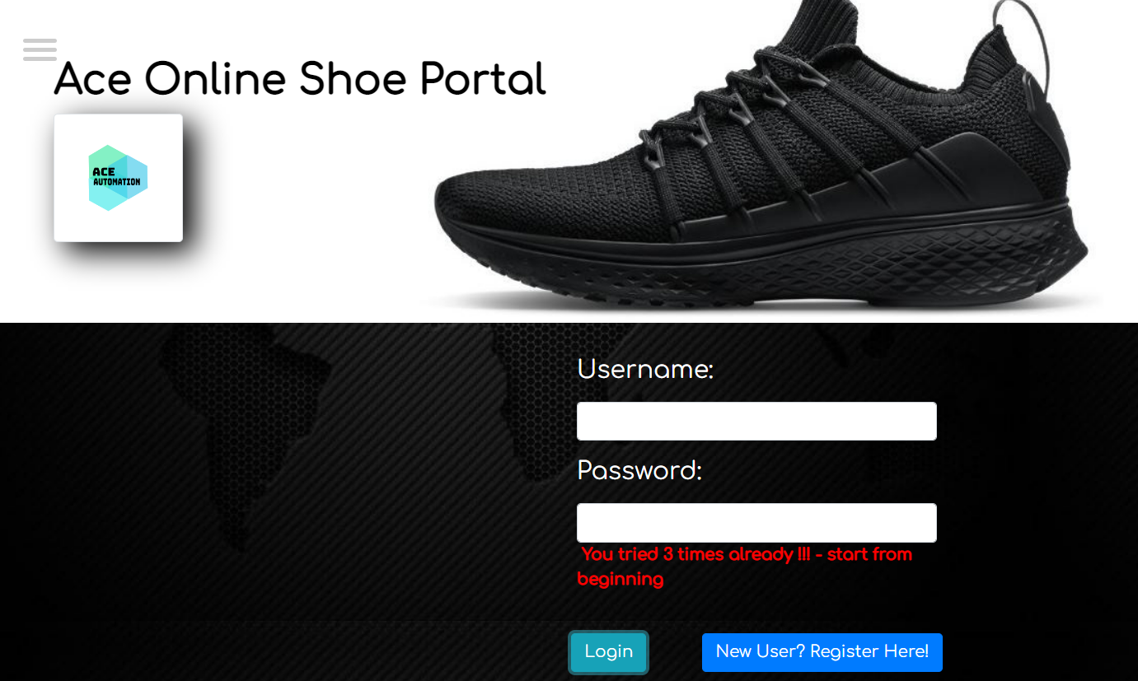
Verify the error message is displayed when user clicks on Login button thrice

Slide 34
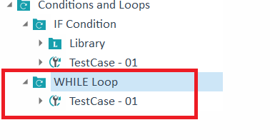
Create a While Folder in Conditions and Loops
Rename it
Copy and Paste TestCase-01

Slide 35
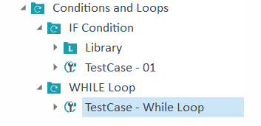
Rename the TestCase - 01

Slide 36
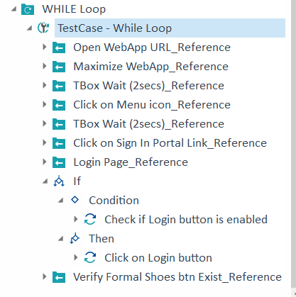
Observe the While Testcase
Cut the ‘THEN’ condition above the Login Page.

Slide 37
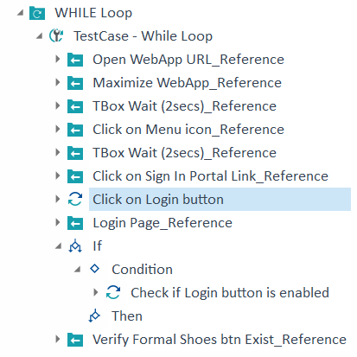
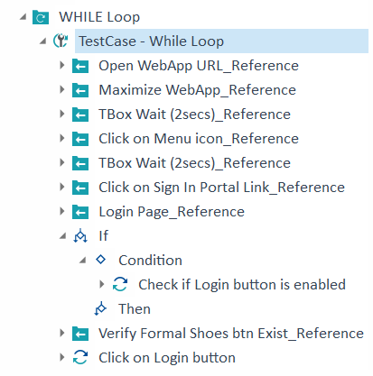
Observe the While Testcase
Cut the ‘THEN’ condition and paste it on the While Loop folderTestCase
Move from the bottom to above the Login Page.

Slide 38
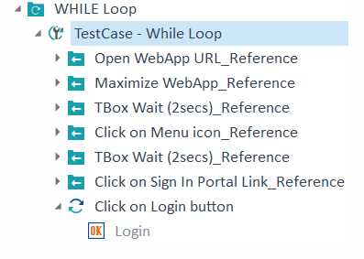
Remove unwanted TestCases
Right click and select Delete
Login Page
If condition
Verify Formal Shoes btn Exist

Slide 39
Remove unwanted TestCases
Right click and select Delete
Login Page
If condition
Verify Formal Shoes btn Exist

Slide 40
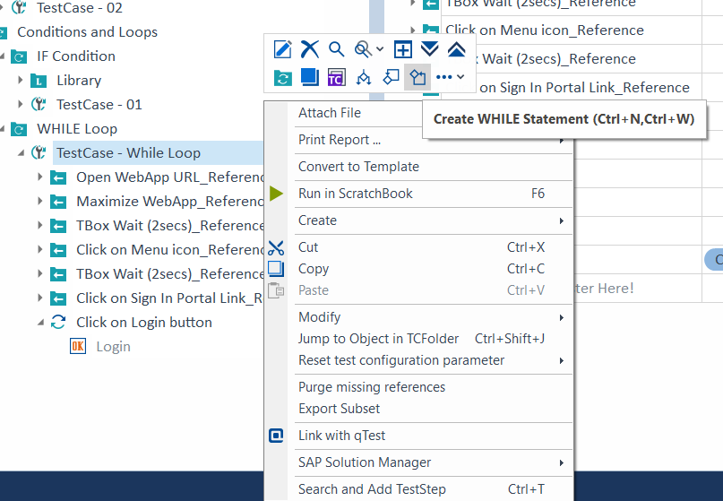
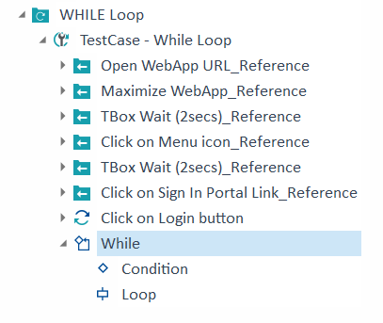
Create While Loop

Slide 41
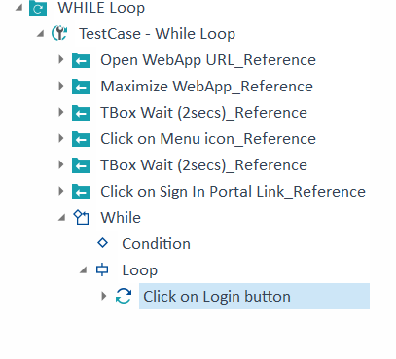
Define Loop
Move Click on Login button TestCase into Loop of Condition
Loop step is created

Slide 42
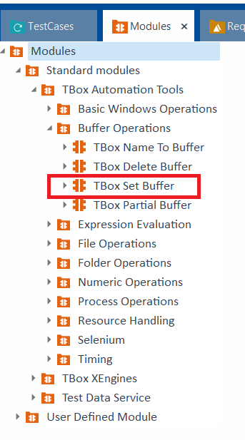
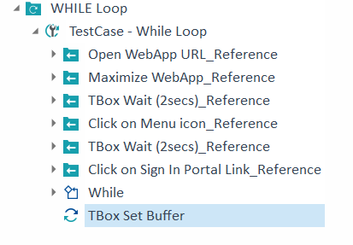
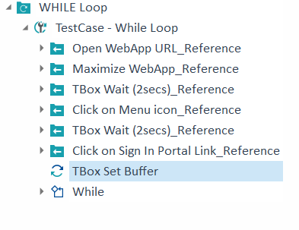
Define Condition
Create a counter that goes from 0 to 3. To identify the 4 clicks.
Select the Tbox Set Buffer Standard Module and drop it into While TestCase.
Move above While loop

Slide 43
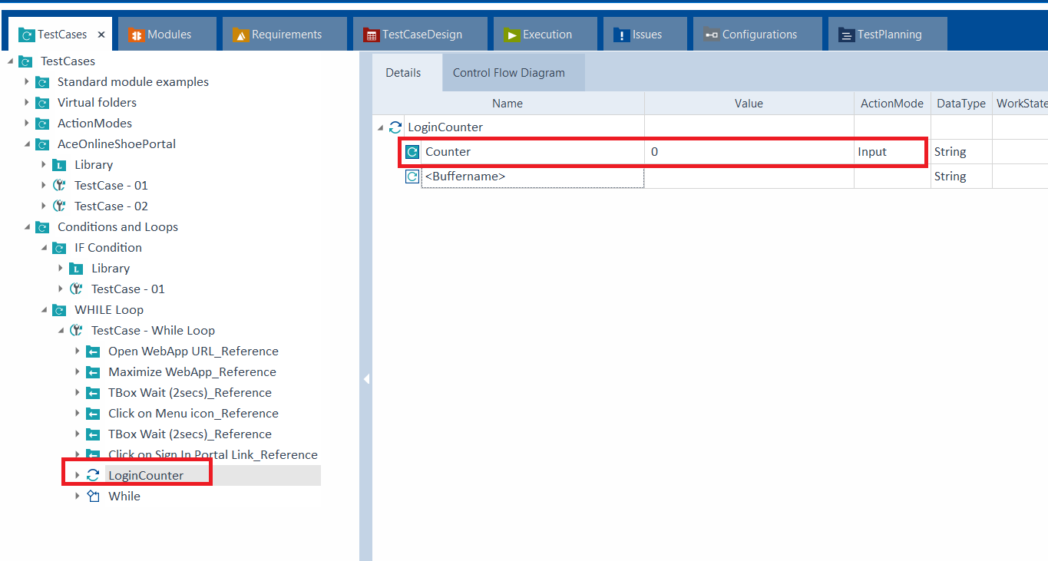
Define Condition – Initialise Counter
Create a counter
Action Mode = Input
Initialise = 0
Rename

Slide 44
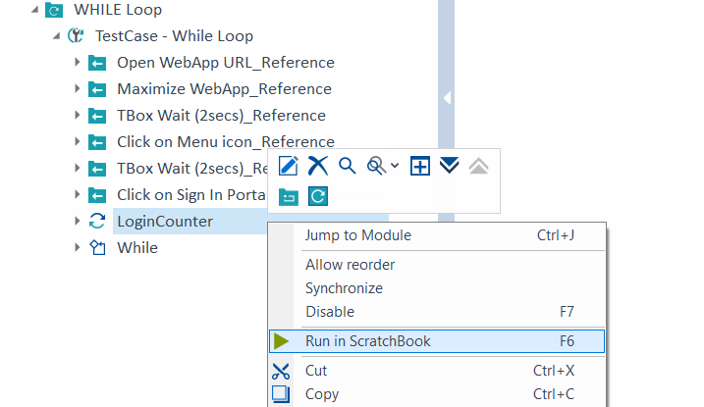
Run Counter
Run only counter testcase

Slide 45
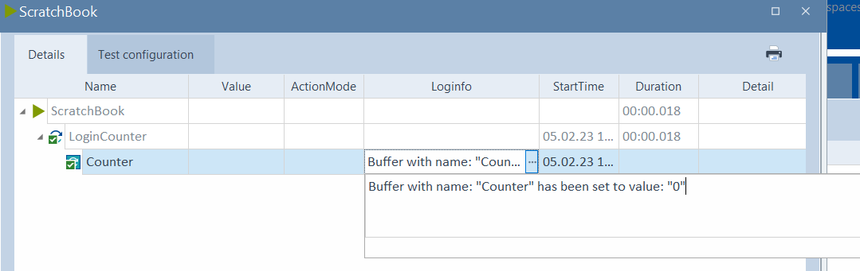
Results - Run Counter
Green bar is displayed. Counter is initialised.

Slide 46
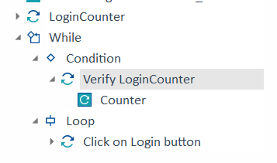

Define Condition – Copy and paste LoginCounter to condition
Copy. Don’t drag and drop.
Rename
ActionMode = Verify
Define the counter value. Loop counter till ActionProperty, Innertext != 4.

Slide 47


Run - Verify Counter
Run only verify counter testcase. View the Results.

Slide 48


Define Loop – Increment the LoginCounter
Copy and paste LoginCounter into Loop of Condition
Rename
Increment the counter
Perform calculations (tricentis.com)

Slide 49

Run & Log – While TestCase
Run testcase. View the Results.

Slide 50
Run – While Loop

Slide 51

Log – While TestCase
Run testcase. View the Results.

Slide 52
DO LOOP

Slide 53
Requirement:
Click on Login Button till the message that you tried 3 times appears.

Slide 54
No Counter involved

Slide 55


Create a folder for DO Loop
Copy and Paste the While Loop TestCase
Rename

Slide 56

DO Loop TestCase
Copy and Paste Click on Login Button from While Loop onto the Do Loop TestCase.
Delete the LoginCounter
Delete While Loop

Slide 57


Create DO Loop in the TestCase
Copy and Paste Click on Login Button from While Loop onto the Do Loop TestCase.
Delete the LoginCounter
Delete While Loop

Slide 58

Modify the Do Loop
Drag and Do Loop above Click on Login Button.
Move the Click on Login Button into the Loop

Slide 59
Define Condition
Loop until the condition is true
Create a User Defined Module to capture the error validation message.

Slide 60

Create a User Defined Module
Open the application

Slide 61

Create a User Defined Module
Scan

Slide 62

Capture the error message span
Finish Screen
Close

Slide 63

User Defined Module Created
Span is present
Rename the Module

Slide 64


Do Loop – Define Condition
Drag and drop the Error Message Module into Do Loop TestCase
Move it to Condition
Rename

Slide 65

Details - Define Condition
ActionMode is Verify
Innertext == Both Username and Password field are required

Slide 66
Run Do Loop
Test Passed

Slide 67

Results
Log

Slide 68

Results
Log

